Slide 1
Clustering Restaurants in Chinatown, Washington

Slide 2

Business Problem Overview
Business Problem – A tourist visiting an unknown city for the first time is often looking for places to eat which are popular in that area but due to unfamiliarity with the set of cuisines and preferences of local people is often confused about which are the best restaurants that he must explore.

Slide 3

Location Overview
Chinatown/Penn Quarter is one of Washington DC's most popular neighbourhoods for dining because of its' central location and easy access to many of the city's biggest attractions including the Verizon Center, the National Portrait Gallery & American Art Museum and the International Spy Museum. Chinatown is just a few blocks away and the Washington Convention Center is also within walking distance.
The Gallery Place-Chinatown Metro station makes this area easily accessible from across the city. Restaurants in the area offer a wide range of cuisine from contemporary American to Asian Fusion, to Italian or Latin American fare. Chinatown has approximately 20 Chinese and Asian restaurants.

Slide 4
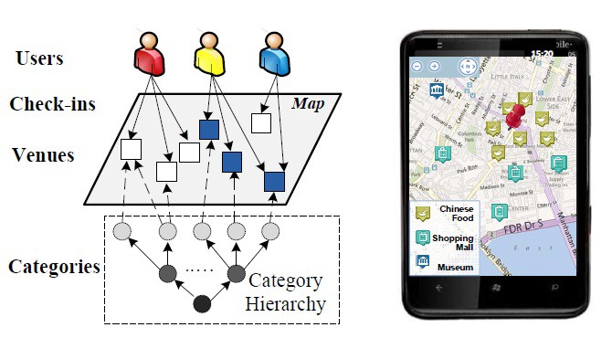
How Clustering can HELP?
K-means clustering algorithm
The K-Means clustering algorithm is an iterative process where you are trying to minimize the distance of the data point from the average data point in the cluster.
Using clustering algorithm we will try to cluster the restaurants based on the number of likes and cuisines
Once the clusters are obtained user can select the desired cluster to select the restaurant he wants to visit.
Since clustering does not provide just a single result it keeps options open for the user to decide from a set of results
Other applications of clustering
Identifying Fake News
Spam filter
Marketing and Sales
Identifying fraudulent or criminal activity
Document Analysis

Slide 5
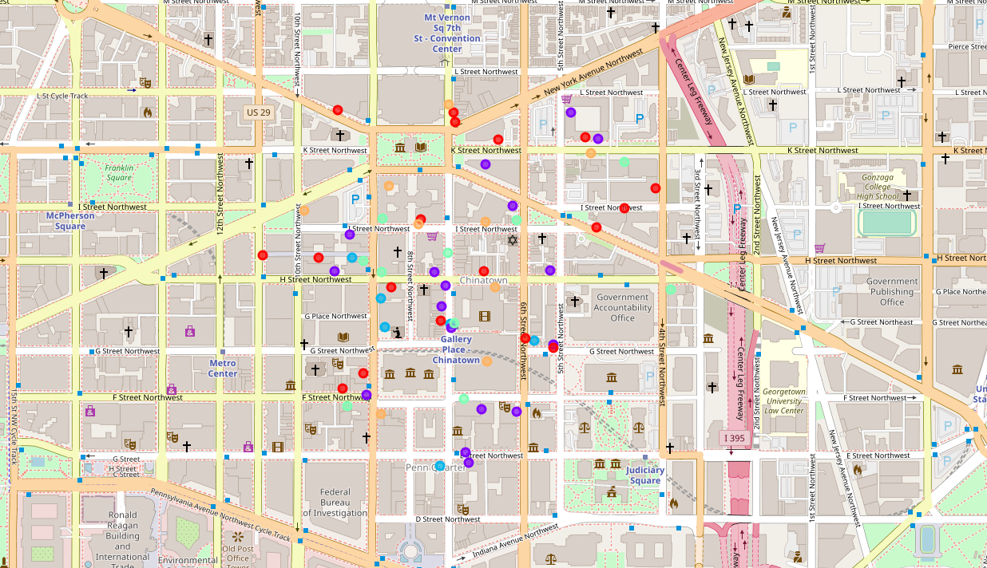
Clusters in the Chinatown
The result on map is containing 6
clusters of restaurants in Chinatown
The clusters are represented by different colors
Below are the major clusters that I obtained –
1) Above Average Restaurant
2) Good Restaurant
3) Middle Eastern and Asian restaurant with 4) best or great rating
5)Great Restaurants
6) Below Average or poor American restaurant

Slide 6
Results
Based on the results obtained on cluster as 6, we observed that the likes and restaurant category have been a determining factor for the categorization of the restaurant.
No locational data was used to test clustering hence we see that all 5 clusters are speeded over the place
Contrary to supervised learning where we have the ground truth to evaluate the model’s performance, clustering analysis doesn’t have a solid evaluation metric that we can use to evaluate the outcome of different clustering algorithms. Moreover, since kmeans requires k as an input and doesn’t learn it from data, there is no right answer in terms of the number of clusters that we should have in any problem.
Using the elbow method we can see that for the given data the ideal number of clusters is not available , so we tested the data for k=5, 9, 11

